Slide 1
Parameters
Notes:
Hi, in this video we’re going to learn how we can use parameters to make our functions even more reusable. Let’s get started!

Slide 2
What is a Parameter?
Parameters give us the ability to customize function commands.
We can use parameters to tailor the values in a function to fit our specific needs.
Notes:
Parameters allow us to customize the commands used in our functions.
Parameters are useful because they give us the ability to tailor our function values to suit our specific needs.

Slide 3
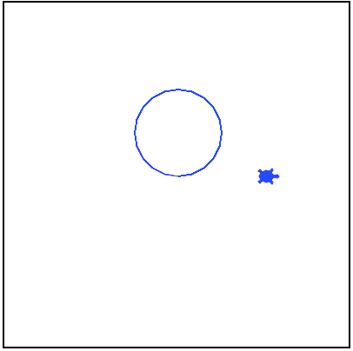
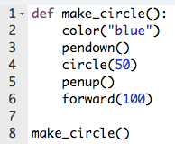
Why Use Parameters?
Notes:
Let’s look at this example function called make_circle. The function is being defined on line 1 and the commands in the function have Tracy draw us a blue circle with a radius of 50 and then move forward the diameter of the circle.

Slide 4
Why Use Parameters?
What if we wanted to make a red circle next?
What if we wanted to draw circles of two different sizes?
Notes:
But what if we wanted to then draw a red circle? Or if we wanted two circles of different sizes? Without the ability to use parameters, we would need to make entirely new functions to accomplish this.

Slide 5
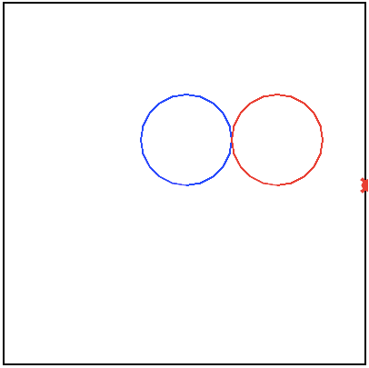
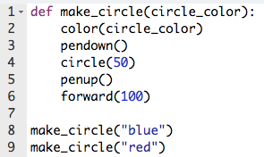
Why Use Parameters?
Notes:
Parameters make it easy to alter certain parts of a function so that we can reuse the same function to accomplish multiple tasks. Let’s take a deeper look into how parameters are created and used.

Slide 6
Using Parameters
In function definition
def function_name(parameters):
Use the parameter values
to control the commands
in function here
In function call
function_name(arguments)
Notes:
To use a parameter, you must first include its name in the function definition. The name you give the parameter, such as color_choice, must be the same name placed throughout your function commands wherever you want to use that value.
(Click for yellow highlight) When calling a function, if the function requires any parameters, you have to include the arguments, or parameter values, between the parentheses so the function can use these values when performing the commands.
You can use as many parameters as you want, but make sure that when calling the function, you enter an argument, or value, for each parameter.
Let’s take a further look at this syntax in action.

Slide 7
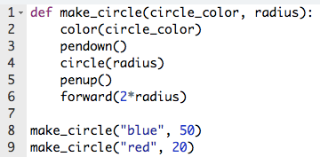
Using Parameters in Function Definition
Parameters Created
Notes:
In this code, we have a function called make_circle that is taking two parameters (Click for arrow) which are called circle_color and radius. The parameters are created between the parentheses after the function name.

Slide 8
Using Parameters in Function Definition
Parameter Used
Parameter Used
Parameter Used
Notes:
The parameters are then being used throughout the function to control (Click for red box and arrow) the color of the circle, (Click for red box and arrow) the radius of the circle, (Click for red box and arrow) and the distance Tracy moves forward after drawing the circle. You’ll notice in the forward command, the radius parameter is being multiplied by 2. You can perform mathematical equations on parameters to control your code even further!

Slide 9
Using Parameters in Function Definition
Parameters given arguments (values)
Notes:
In our function call, you’ll see that we have provided the two arguments to be used throughout the function. We are first using blue for our circle_color parameter and 50 for our radius parameter. Tracy reads the arguments in order an assigns them to the parameters in the same order. After the first function is complete, the same function is being called but instead with red for the circle_color parameter and 20 for the radius.

Slide 10
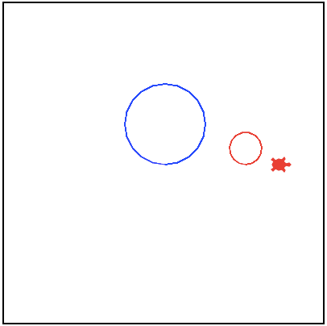
Using Parameters in Function Definition
Output
Notes:
When we run this code, this is the output we get, and we did it all in just 9 lines of code!

Slide 11
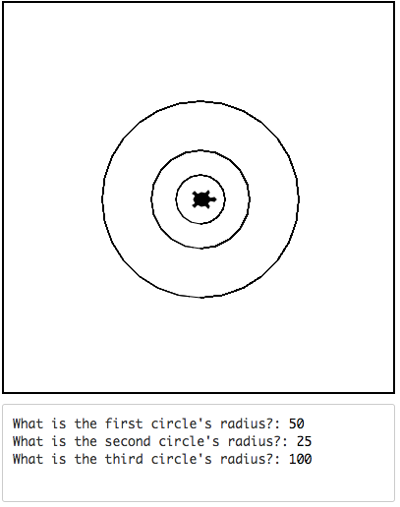
Example #1: Concentric Circles
Write a program that asks a user for 3 radius values and then draws three circles with those radii centered on the canvas.
Notes:
In this example, we want to ask the user for three radius values and then draw three circle centered on the canvas with those radii. Because we’re not going to know what the radius values are going to be ahead of time, we need to write a code that will be able to work for any value entered. Let’s do a bit of planning before we start coding.

Slide 12
Example #1: Concentric Circles
Big Circle Radius: 100
Move down 100
Medium Circle Radius: 50
Move down 50
Small Circle Radius: 25
Move down 25
Circle Radius: x
Move down x
Notes:
Let’s start with the biggest circle here. The radius of this circle is 100 and we needed to move down 100 to get the the bottom of the circle. (Click for red arrow and label) For the medium sized circle, its radius is 50 and we needed to move Tracy down 50 pixels to get the the bottom. (Click for red arrow and label) And for the smallest circle, its radius is 25 and we needed to move 25 pixels down to the bottom. So we can make the correlation (Click for line and red label) that no matter what the radius is, we need to move Tracy down the same amount as the radius to get to the bottom. In order for this to always work though, before we start drawing the next circle, we need to move Tracy back to the center position. Now let’s write this code.

Slide 13
Commands Learned this Lesson
Command | What does it do?
def function_name(parameters) | Defines a function with parameters
function_name(arguments) | Calls a function with arguments
Notes:
In this lesson, we learned how to use parameters to make our functions even more reusable. Now it’s your turn to write some Tracy programs of your own using parameters!

